Slide 1
Supplements vs. Foods: What’s the Verdict?
Debate

Slide 2

InstaPoll
When you think of dietary supplements, what are the first ones that come to mind?
Multivitamins
Calcium
Vitamins
Protein
Fish Oils
Probiotics
Herbs

Slide 3
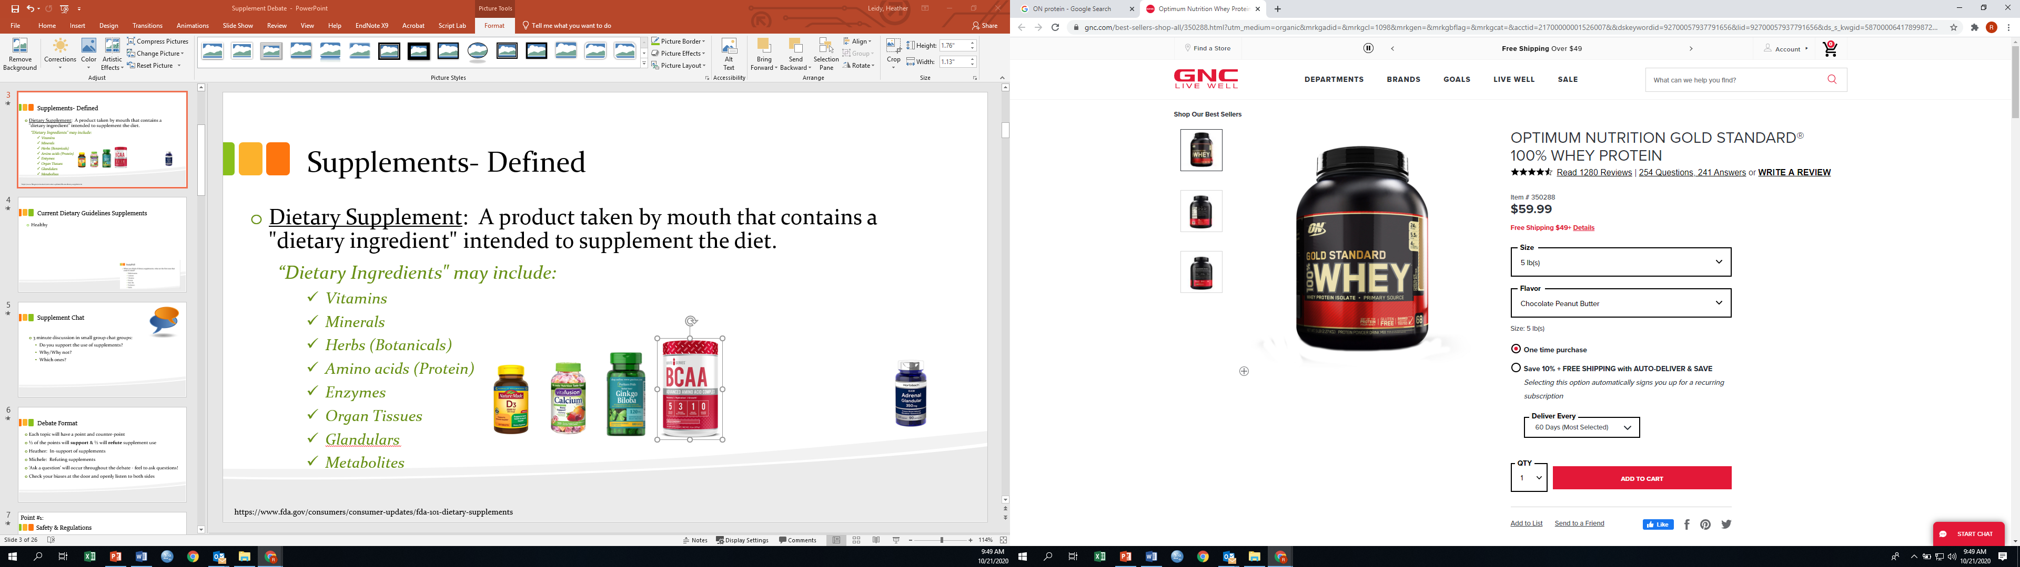
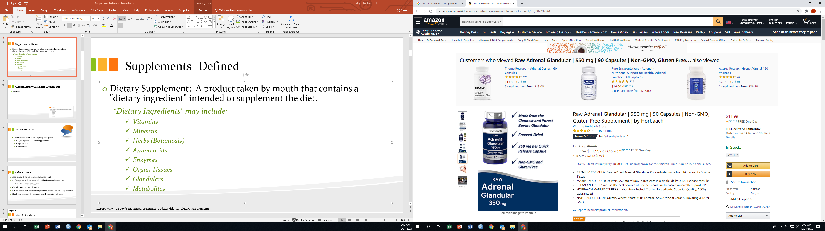
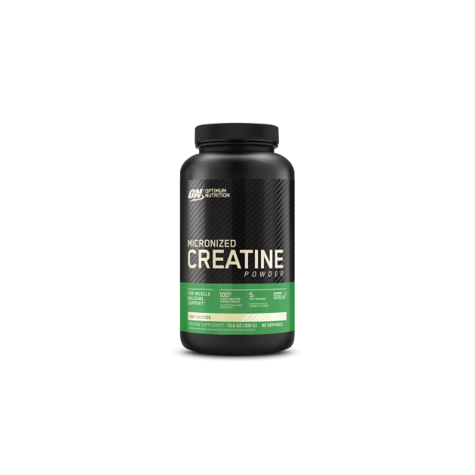
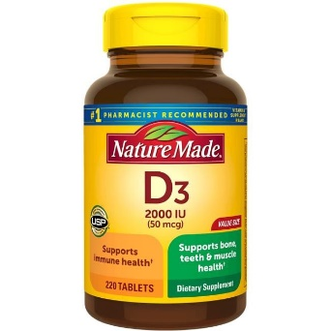
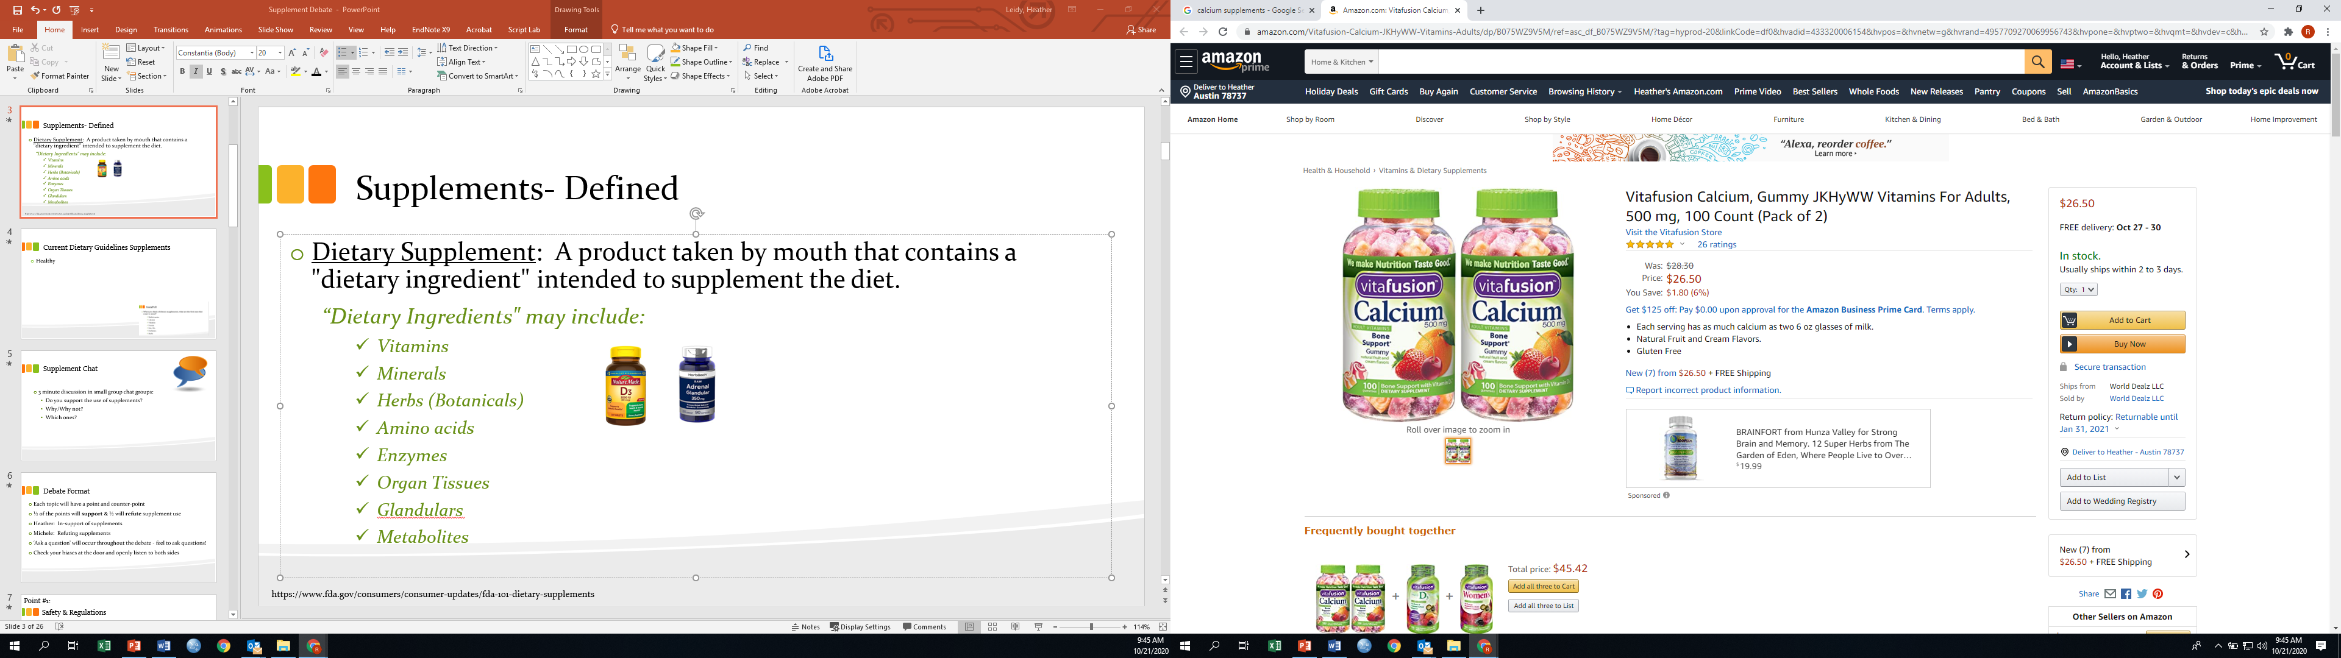
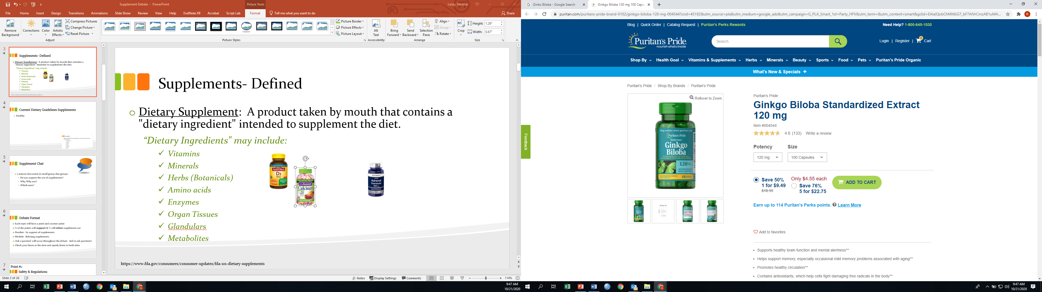
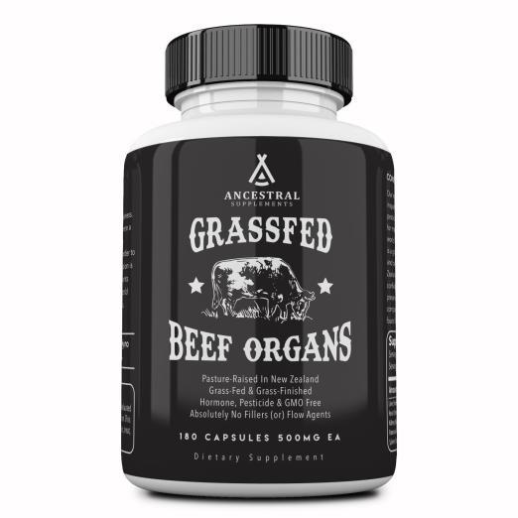
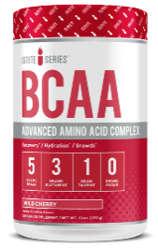
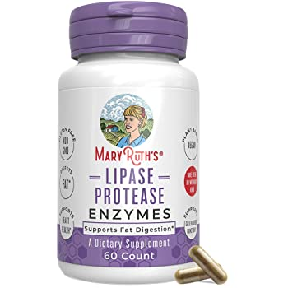
Supplements- Defined
Dietary Supplement: A product taken by mouth that contains a "dietary ingredient" intended to supplement the diet.
“Dietary Ingredients" may include:
Vitamins Minerals Herbs (Botanicals) AAs (Protein) Enzymes Organ Tissues Glandulars Metabolites
Supplements come in: tablets, capsules, softgels, gelcaps, liquids, powders, or bars
https://www.fda.gov/consumers/consumer-updates/fda-101-dietary-supplements

Slide 4
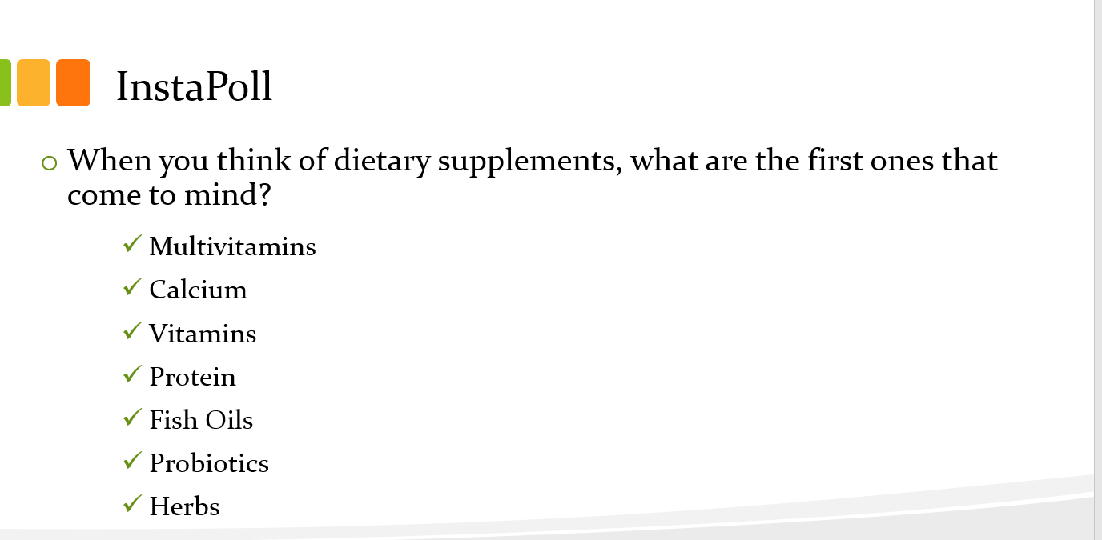
2015-2020 Dietary Guidelines
Nutritional needs should be met primarily from foods.
Dietary supplements may be useful in providing one or more nutrients:
That may be consumed in less-than-recommended amounts
That are of particular concern for specific population groups.
Specific reference: folic acid (women capable of becoming pregnant)

Slide 5

Supplement Chat
3 minute discussion in small group chat groups:
Do you support the use of supplements?
Why/Why not?
Which ones?

Slide 6

Debate Format
Each topic will have a point and counter-point
Half of the points will support and half will refute supplement use
Heather: In support of supplements
Michele: Refuting supplements
‘Ask a question’ will occur throughout the debate - feel to ask questions!
Check your biases at the door and openly listen to both sides

Slide 7

InstaPoll
Were you under the DRI requirement for any nutrient based on your 3-day diet?
Yes
No

Slide 8

Point #1:
Helpful in meeting requirements
protein
protein
protein
iron
iron
Vit B_{B12}
Nutrients
Highlighted in
2020 DGA
Vit D
zinc
Shortfall Nutrients
Vit A
Vit E
Vit D
Magnesium
25%
Americans
Vit C
Folate
Calcium
Fiber

Slide 9
Point #1:
Helpful in meeting requirements
https://www.eatrightpro.org/-/media/eatrightpro-files/practice/position-and-practice-papers/position-papers/micronutrientsupplementation.pdf

Slide 10
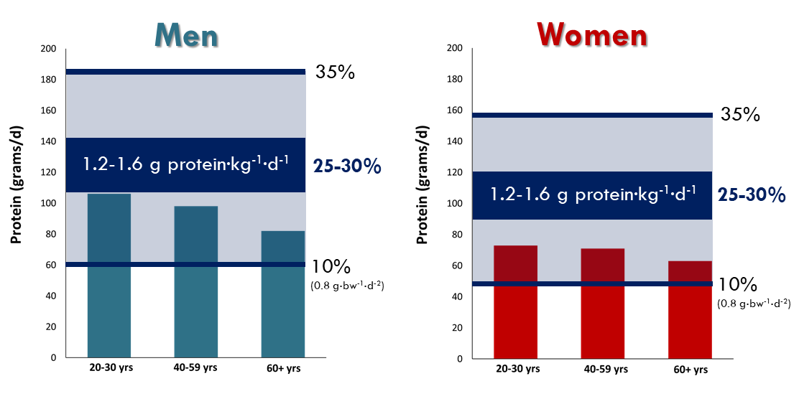
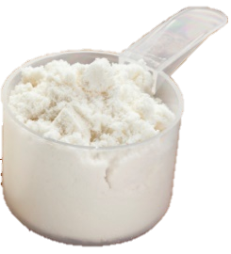
Point #1:
Helpful in meeting requirements
& Beyond
Whey Protein Isolate
140 kcals
30 g protein
1 g Fat
3 g CHO (1 g sugar)
https://www.ars.usda.gov/ARSUserFiles/80400530/pdf/DBrief/29_Protein_Intake_of_Adults_1516.pdf

Slide 11

Counter-point #1:
Can Lead to Overconsumption/Toxicity
Toxicity
Difficult to know actual deficiencies based on anecdotal symptoms (e.g. I’m so tired lately… I must be iron-deficient!) or through imperfect self-analysis (e.g. MyFitnessPal)
Supplement users are more likely to have excessive intakes - can easily go unrecognized
At most, supplements should only supply 50-150% of DV for various nutrients
Some toxicities can occur with as little as 2.5 time the RDA

Slide 12
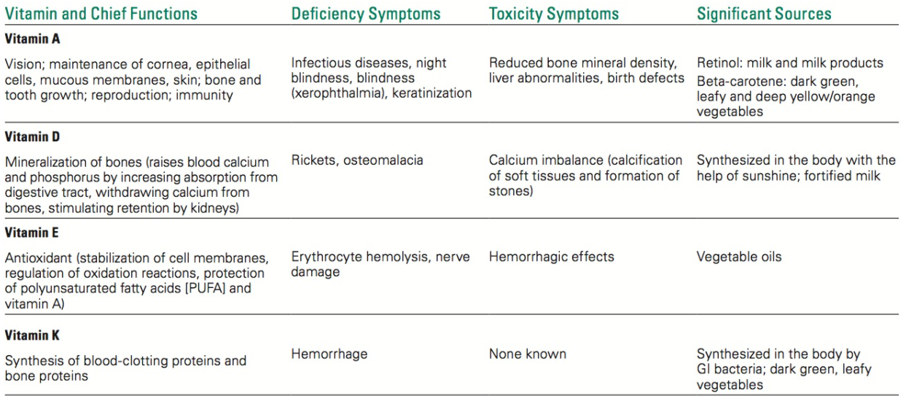
Counter-point #1:
Can Lead to Overconsumption/Toxicity

Slide 13
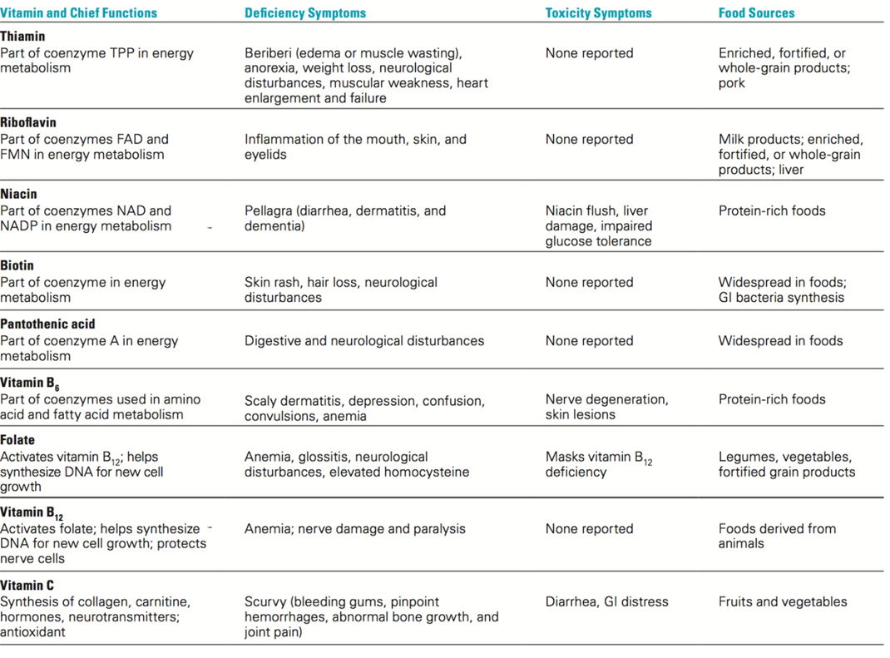
Counter-point #1:
Can Lead to Overconsumption/Toxicity

Slide 14
Counter-point #1:
Can Lead to Overconsumption/Toxicity
Toxicity
Especially at risk: children (smaller amount needed, lower tolerance)
Micronutrient | Health effects associated with excessive intake | Percentage of 2-to-8-year-old children exceeding UL |  | Estimated number of 2-to-8-year-olds over-exposed from food + supplements
 |  | Children who don’t take supplements | Children who take supplements
Vitamin A | Liver damage; brittle nails; hair loss; skeletal abnormalities; osteoporosis and hip fracture (in older adults); developmental abnormalities (of the fetus) | 13% | 72% | 10.6 million
Zinc | Impaired copper absorption; anemia; changes in red and white blood cells; impaired immune function | 45% | 53-84% | 13.5-17.2 million
Niacin (B3) | Skin reactions (flushing, rash); nausea; liver toxicity | 8% | 28% | 4.7 million
Bailey RL, Fulgoni VL 3rd, Keast DR, Lentino CV, Dwyer JT. 2012a. Do dietary supplements improve micronutrient sufficiency in children and adolescents?
Berner LA, Keast DR, Regan RL, Dwyer JT. 2014. Fortified Foods Are Major Contributors to Nutrient Intakes in Diets of US Children and Adolescents.

Slide 15
Counter-point #1:
Can Lead to Overconsumption/Toxicity
Life-threatening misinformation
False claims, no guarantee of effectiveness
Take more to achieve faster results…

Slide 16
Counter-point #1:
Can Lead to Overconsumption/Toxicity
“Guaranteed immediate
weight loss!"
Life-threatening misinformation
False claims, no guarantee of effectiveness
Take more to achieve faster results…
“Promotes molecule multiplicity"
"Proven to treat rheumatism, arthritis, infections, prostate problems, ulcers, cancer, heart trouble, hardening of the arteries and more."
“Shrinks tumors!"
“Nobel Prize-winning technology"
“Prevents memory loss!"
“Cures gout!"

Slide 17

Questions?

Slide 18
Point #2:
Safety & Regulation Concerns
Regulated by Food and Drug Administration (FDA) as foods
May have several times RDA of micronutrients
1994 Dietary Supplement Health and Education Act
Original Purpose: enable consumers to make informed choices
Same general labeling requirements as foods
Net effect: deregulation of supplement industry
Nutrient claim
Health Claim
Structure-Function Claim
More regulation
Less regulation: do NOT need FDA approval

Slide 19
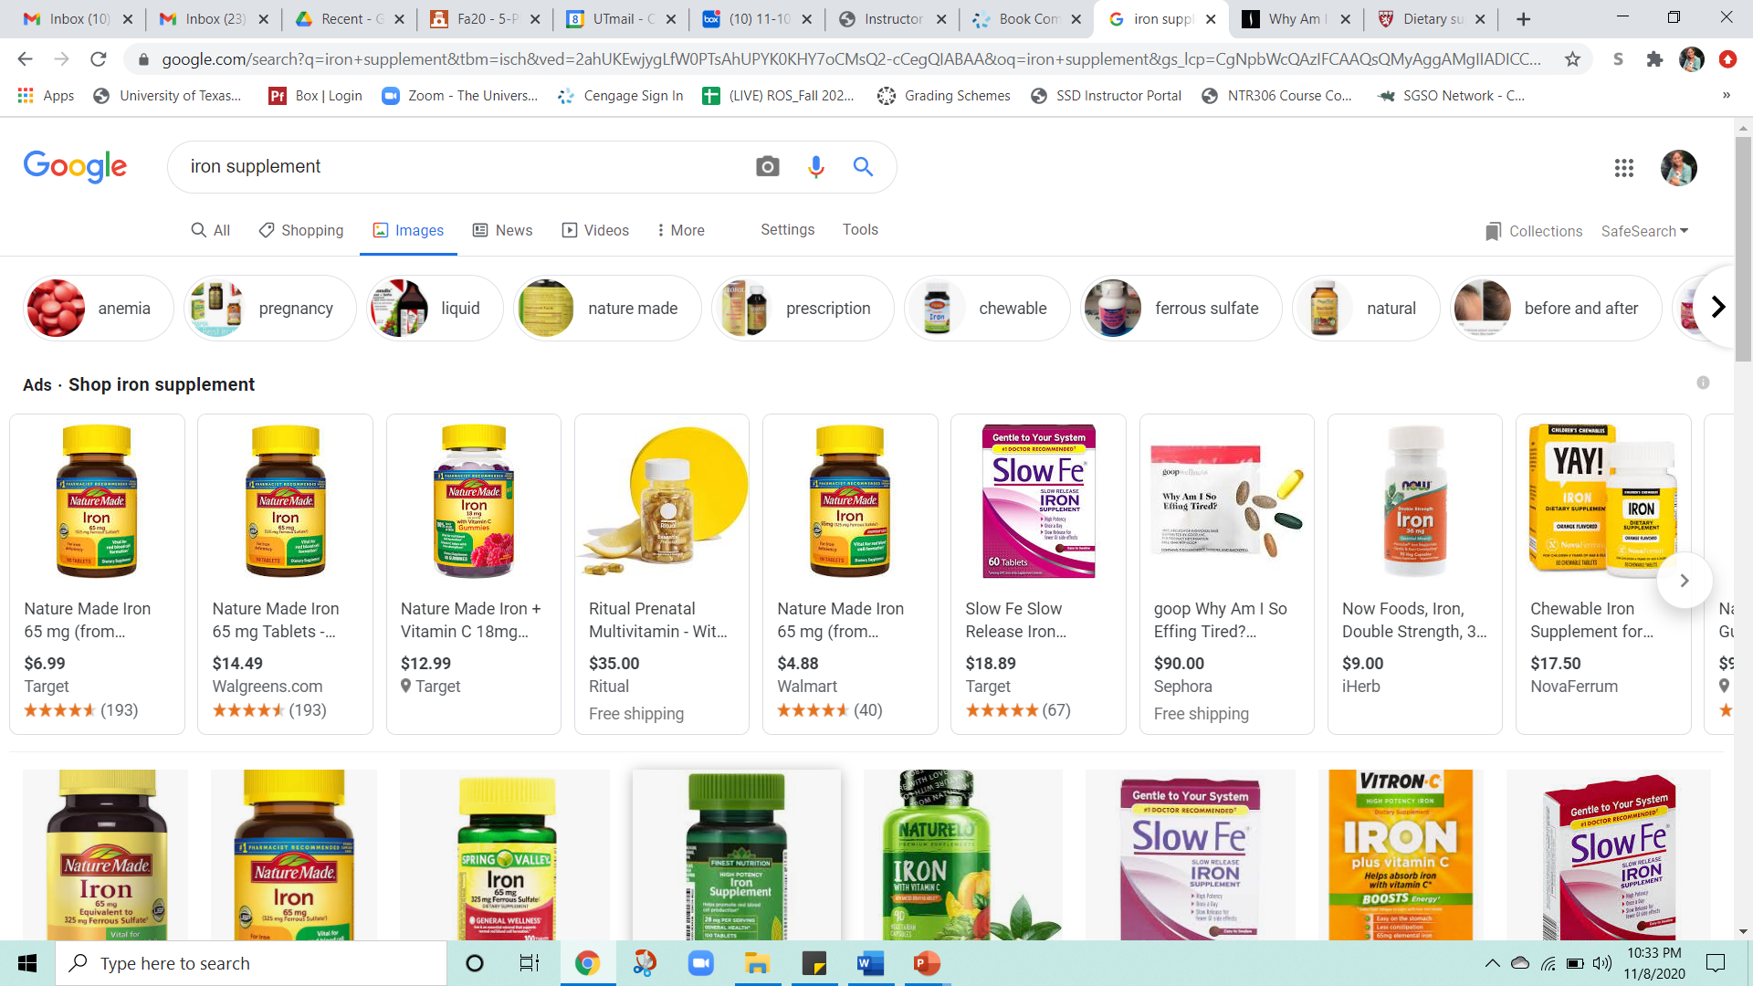
Point #2:
Safety & Regulation Concerns
Deregulation of supplements:
Do NOT need to be proved safe or effective
Do NOT need FDA approval before being marketed
No standards (across brands, etc.) for:
Potency
Dosage
Effectiveness (when combining ingredients)
No warning label requirements for side effects
Only requirement: good manufacturing practices
Quality packaging
No contaminants
Labels reflect contents

Slide 20
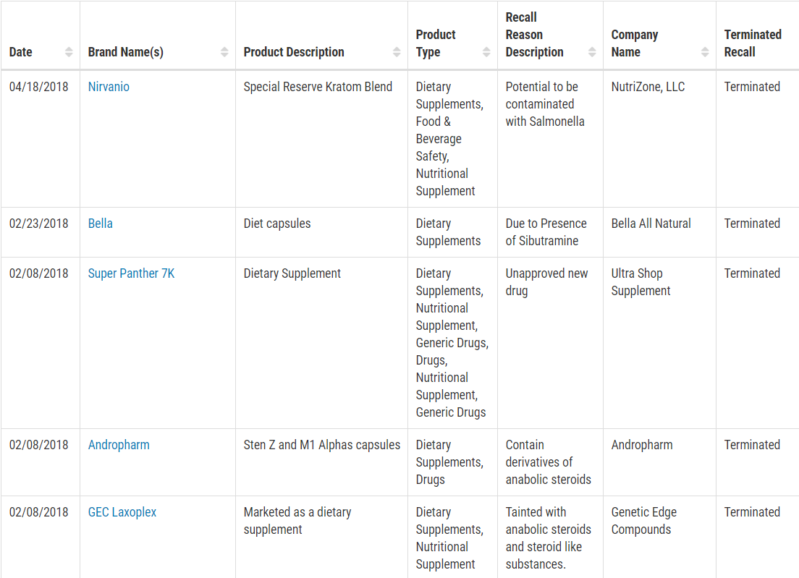
Point #2:
Safety & Regulation Concerns
FDA Recalls, Market Withdrawals, and Safety Alerts
https://www.fda.gov/safety/recalls-market-withdrawals-safety-alerts

Slide 21
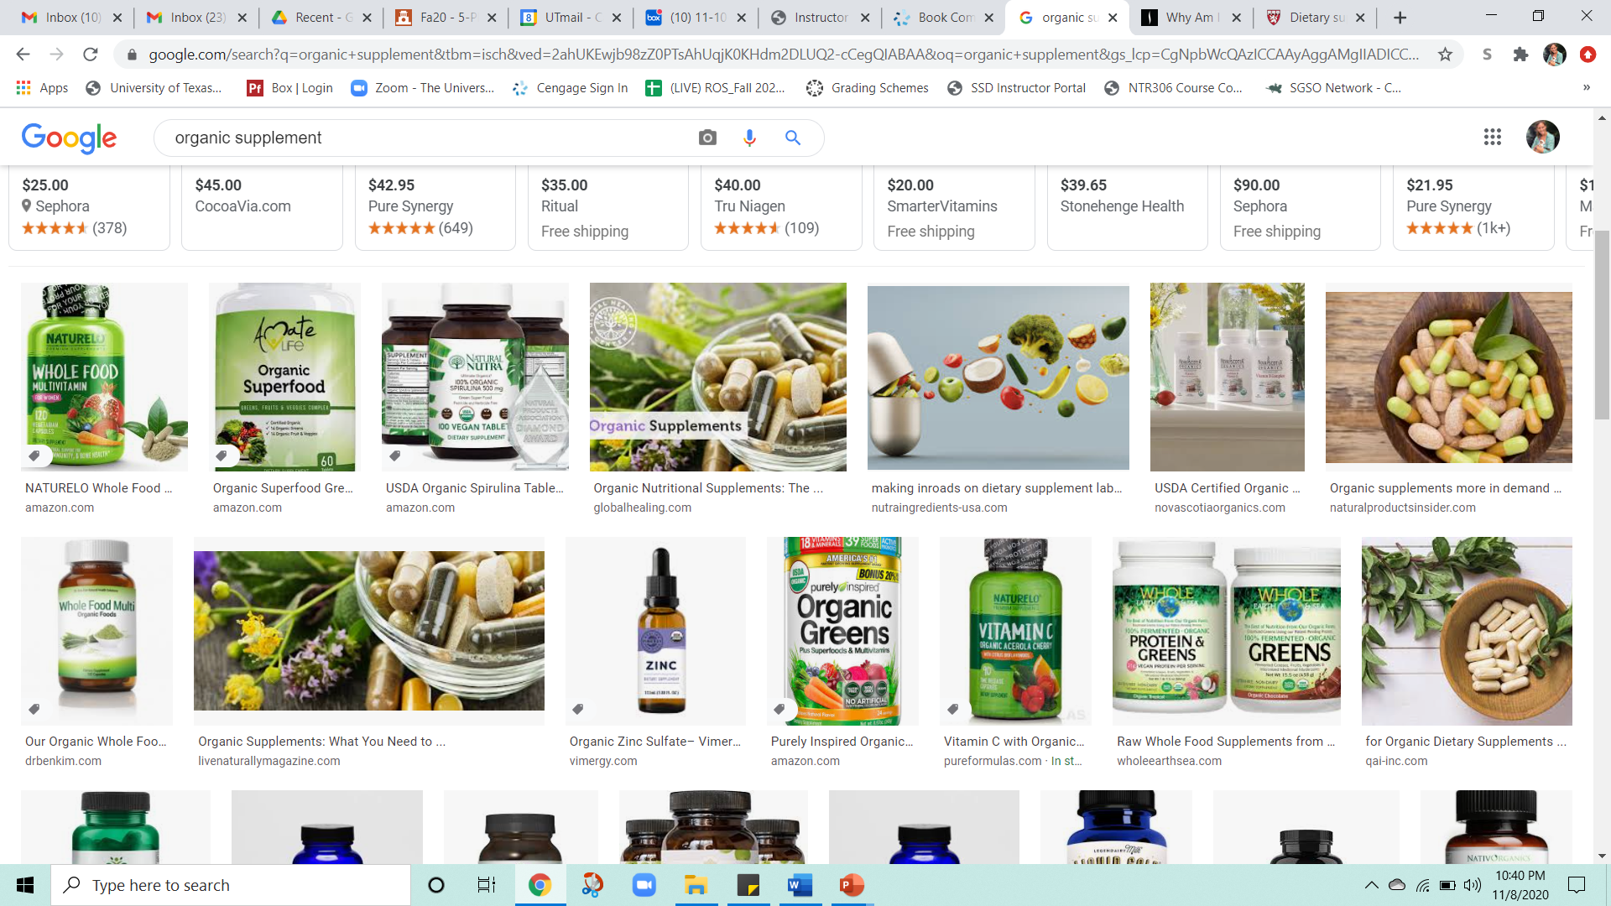
Point #2:
Safety & Regulation Concerns
Organic or natural = not more effective, but more expensive
USDA Certified Organic – what does that mean for consumers?
Marketing strategies:
Fake vitamins = dangerous!
“Green” pills = veggies are cheaper and better for you!
Stress relief = false!
Beware of internet advertising

Slide 22
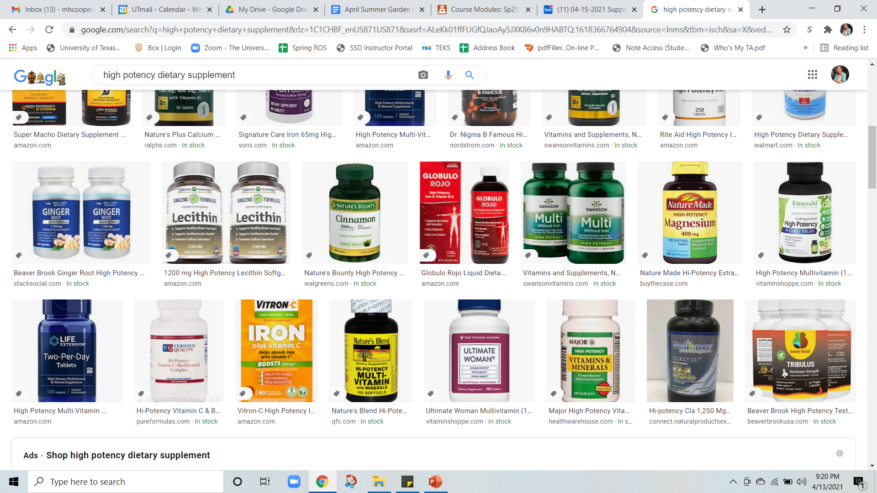
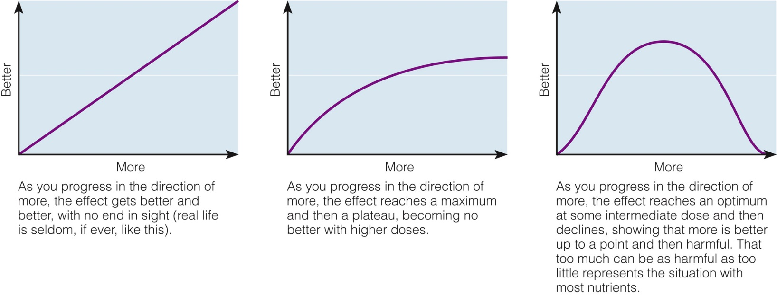
Point #2:
Safety & Regulation Concerns
Beware of high potency claims (more ≠ better)

Slide 23
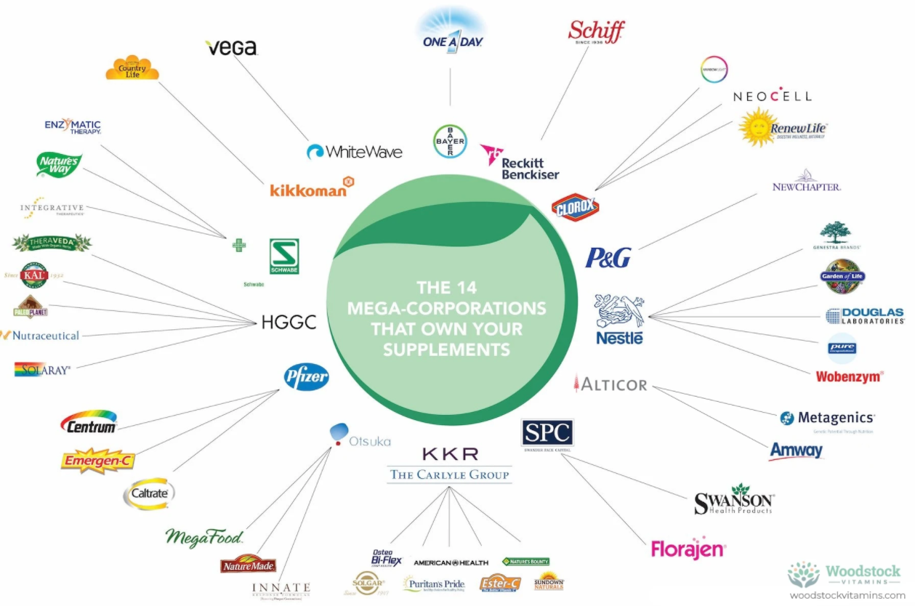
Counter-Point #2:
Safety & Regulations Exist
Regulated by the Food and Drug Administration (FDA)
1994, Dietary Supplement Health and Education Act (DSHEA) set safety & labeling
2011, Food Safety Modernization Act sets rule for new ingredients
https://www.fda.gov/food/information-consumers-using-dietary-supplements/questions-and-answers-dietary-supplements

Slide 24
Counter-Point #2:
Safety & Regulations Exist
Safety procedures:
Manufacturer is responsible to make sure the supplement is:
Safe / Unadulterated / Produced with good manufacturing practices
Quality
Potency
Purity
Efficacy
Properly and truthfully marked with a label
Reported to FDA when harmful effects are identified
Ingredients have to be federally regulated
Ingredients must be GRAS listed (generally recognized as safe)
https://pubmed.ncbi.nlm.nih.gov/30366569/

Slide 25

Counter-Point #2:
Safety & Regulations Exist
Safety procedures:
Respected manufacturers make sure the supplement is:
High-quality laboratory tested
Compliant with US Parmacopeia Convention (USP)
https://pubmed.ncbi.nlm.nih.gov/30366569/

Slide 26
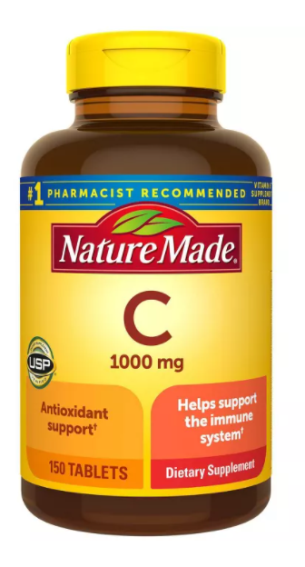
Counter-Point #2:
Safety & Regulations Exist
Labeling Claims:
Must not say it’s a conventional food or a sole item of a meal or diet.
Must say it is a dietary supplement
FDA approved:
Health Claims
Nutrient Claims
Structure/Function Claims
Disclaimers are added (not intended to diagnose, treat, cure, prevent disease)
https://pubmed.ncbi.nlm.nih.gov/30366569/

Slide 27
Counter-Point #2:
Safety & Regulations Exist
Labeling:
Name & Supplement
Quantity
Manufacturer Name & Location
Directions for using the Product
Supplement Facts Panel:
Serving Size
% daily value (DV)
Dietary & Non-dietary ingredients
May include statement about potential side effects
https://pubmed.ncbi.nlm.nih.gov/30366569/

Slide 28
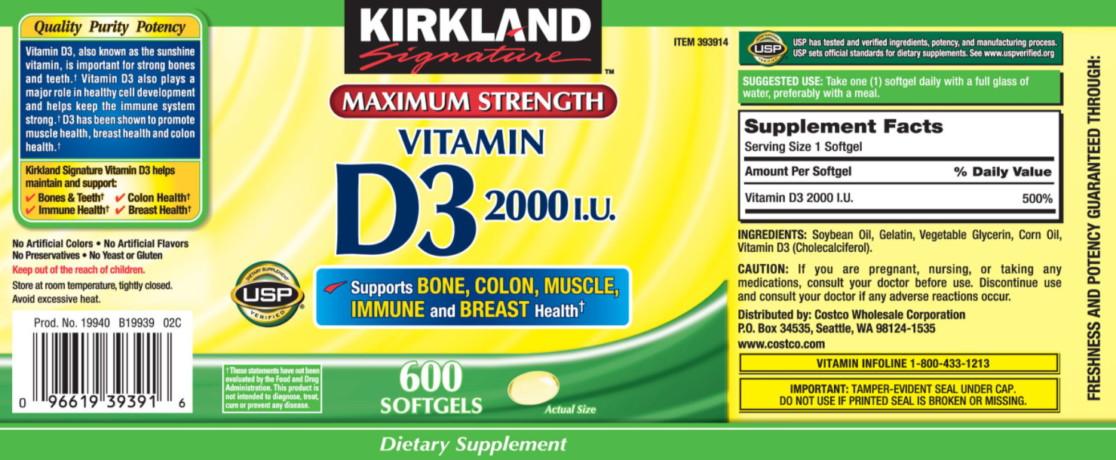
Counter-Point #2:
Safety & Regulations Exist

Slide 29
Counter-Point #2:
Safety & Regulations Exist
Tolerable Upper Limit Intake Levels (UL)
Prevalence of the US population that exceeds the UL is low
Adults:
Iron & Zinc (9%)
Folate (7%)
Calcium & Magnesium (6%)
Vit A & B6 (3%)
Vit C (2%)
Exceptions: Children ages 2-8 years
Zinc (84%)
Folate & Vit A (70%)
(Can exceed the UL from food sources alone)
https://pubmed.ncbi.nlm.nih.gov/30366569/

Slide 30
Questions?

Slide 31

Point #3:
Required/Encouraged for specific groups
Exclusively Human Milk-fed Infants: < 9 months
Susceptible to deficiencies in:
Zinc, Protein, Iron
Iron supplementation only recommended for iron-deficiency anemia
Infants: < 9 months
Susceptible to deficiencies in:
Potassium, Vit D, E, Choline
Vit D supplementation only recommended & only 400 IU

Slide 32

Point #3:
Required/Encouraged for specific groups
Pregnant Women (or those able to become pregnant):
Susceptible to deficiencies in:
Calcium, Protein, Iron, Vit D, Magnesium, Choline, Folate
Folate supplementation only recommended & at 400-800 ug/day

Slide 33

Point #3:
Required/Encouraged for specific groups
Older adults (especially women):
Susceptible to deficiencies in:
Vit B12, Vit B6, Protein
B12 supplementation recommended (2.4 ug/day)
Protein recommended (+30-40 g protein)

Slide 34
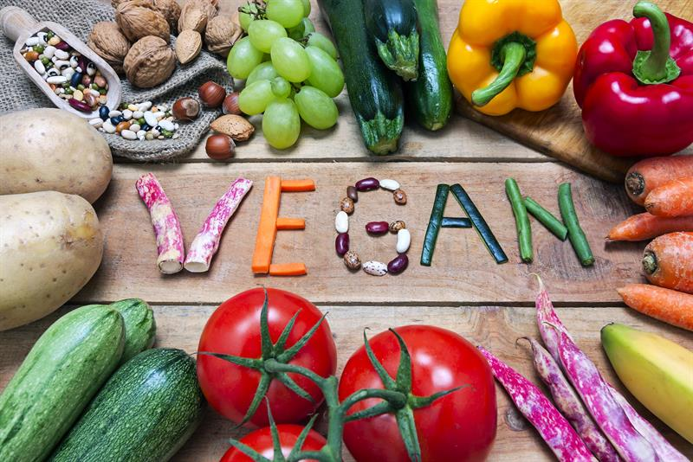
Point #3:
Required/encourage for specific groups
Adults following diets not recommended by Dietary Guidelines
Vegan Diets (calcium, vit D, B12)
Low-calorie Diets (protein, micronutrients, etc.)
Low CHO Diets (micronutrients)
Adults with Health Conditions
Lactose Intolerance
Inflammation/Disease
Genetic Disorders

Slide 35
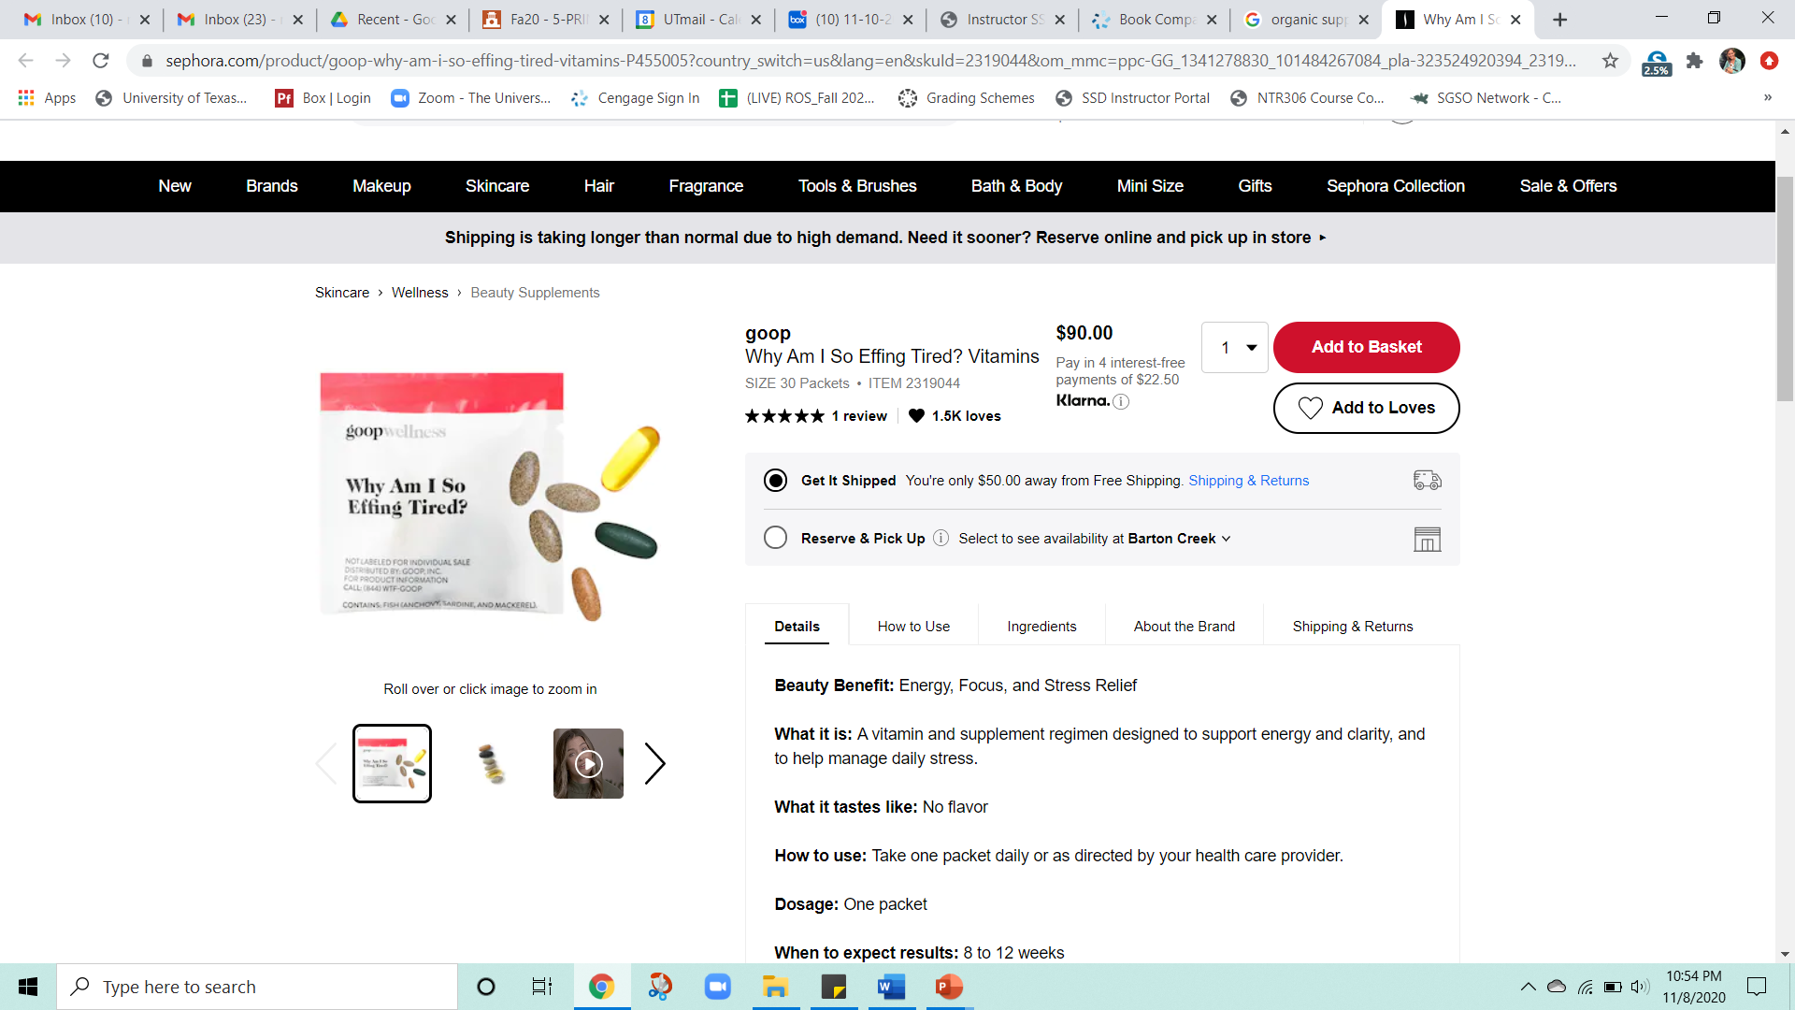

Counter-point #3:
Not Suited for the General Population
False sense of security
Can lead to poor dietary choices
Supplements do NOT negate health implications of poor diet
Invalid rationale for supplementation:
Food or soil contains inadequate nutrients
Provide energy
Enhance athletic performance
Help with stress
Cure ailments

Slide 36
Counter-point #3:
Not Suited for the General Population
Bioavailability
Usually food > supplements
Exception: folate (1.7 times more bioavailable)
Antagonistic actions: supplements may interfere with actions of other nutrients
Excess of one (manganese) → deficiency in another (iron)
Excess of one (calcium) → malabsorption of another (iron)
Excess of one (folate) → mask deficiency of another (B12)

Slide 37

Counter-point #3:
Not Suited for the General Population
Mostly self-prescribed
Less information about toxicity, interactions, bioavailability than RD (or other medical professional)
Improving food choices is preferred course of action
Consult with Registered Dietitian to improve nutrient intake through food
Balance and variety are key!

Slide 38
Questions?

Slide 39
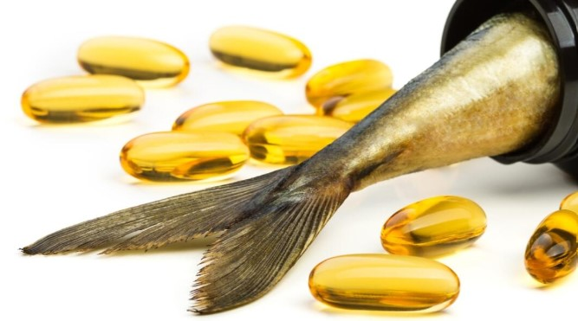
Point #4:
Can be Very Co$tly
Taken as ‘dietary insurance’
Costly but harmless practice… Or costly and harmful
Vitamin D3: $0.01 – 0.05 /serving
Creatine: $0.05 – 0.50 /serving
Median cost: $0.20 – 0.30
Fish oil: $0.05 – 1.00 /serving
Median cost: $0.20 – 0.30
https://datafiniti.co/supplement-pricing/#:~:text=There's%20a%20huge%20range%20in,is%20%240.01%20%E2%80%93%20%240.09%2Fserving.

Slide 40
Point #4:
Can be Very Co$tly (in multiple ways)
Big picture of supplement cost:
Lots of variation in price
Single ingredient supplements: usually identical ingredients – difference in claims or purported benefits increases price
Multi-ingredient supplements: large variation in formula and cost – what are you paying for…?

Slide 41
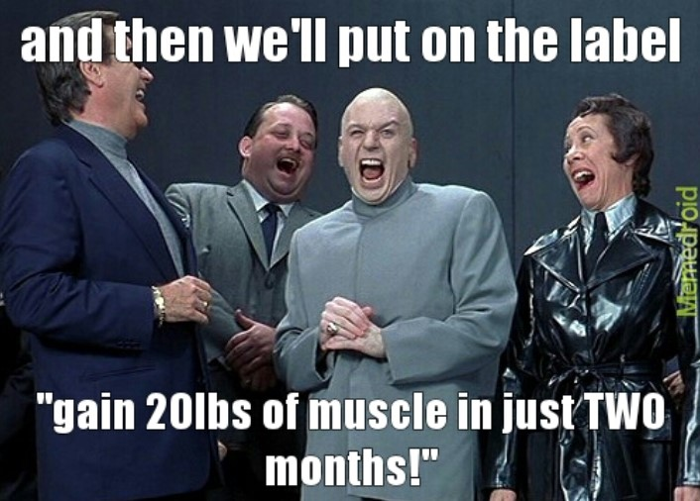
Point #4:
Can be Very Co$tly (in multiple ways)
Big picture of supplement cost:
More expensive ≠ higher quality!
Loss of unquantifiable benefits
Fish oil: $0.20/serving → $72/year
Fish (salmon): ~$15/pound = $7.50/serving/week → $390/year
Benefits of food! Micronutrients, additional macronutrients, skills of preparing food, pleasure of eating, sensory experiences, etc.

Slide 42
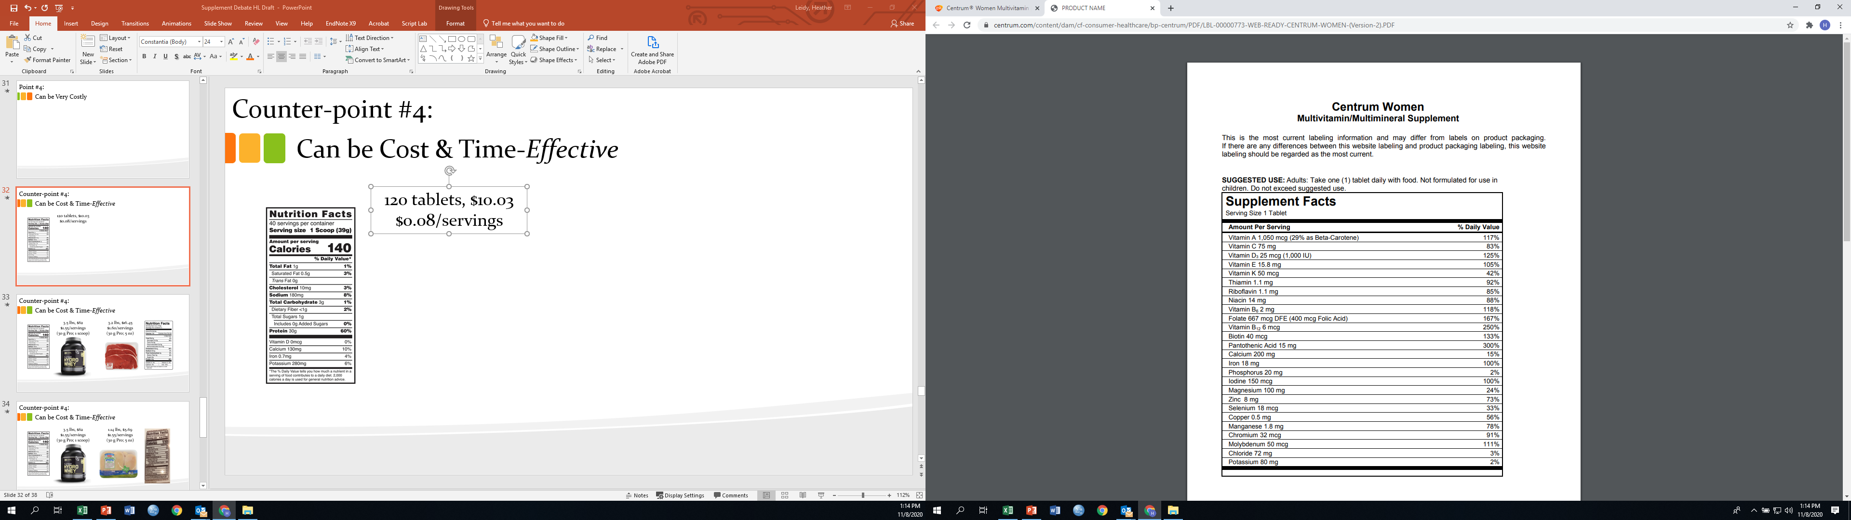
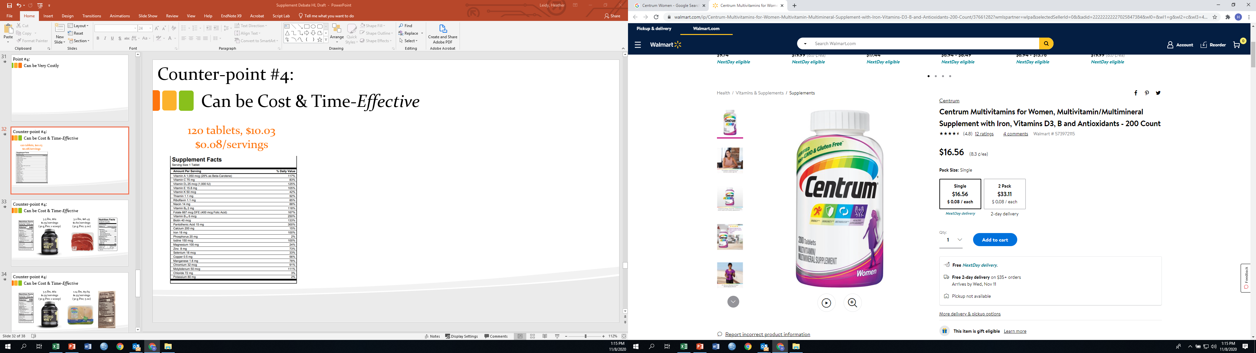
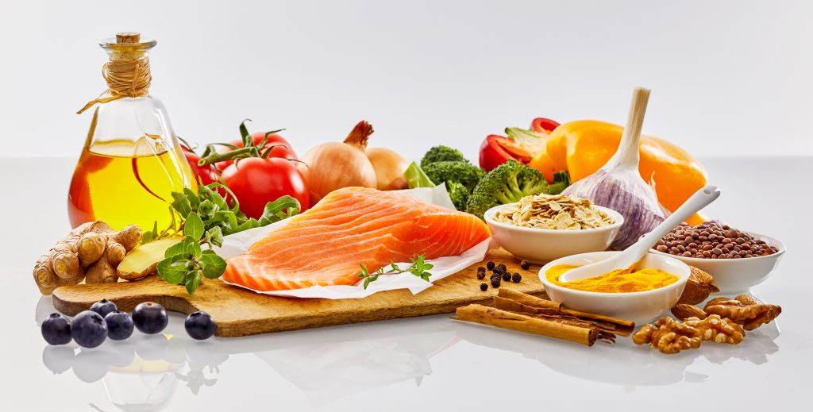
Counter-point #4:
Can be Cost & Time-Effective
200 tablets, $16.56
$0.08/servings
Example: Blue Apron’s Mediterranean diet meal ($10.99 /servings )
(NOT A FAIR COMPARISON)
Vs.

Slide 43
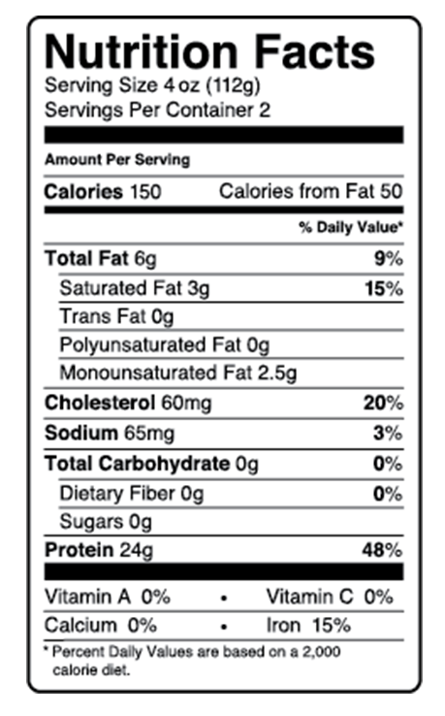
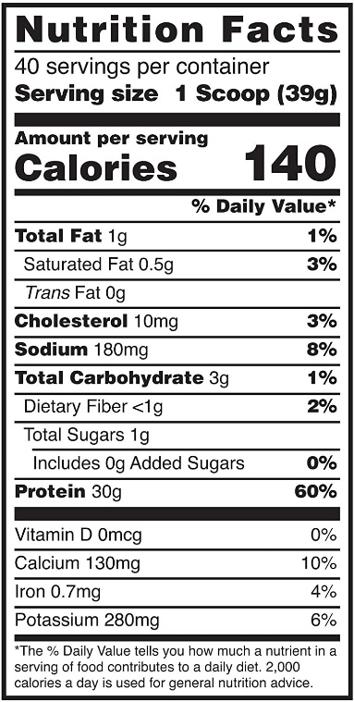
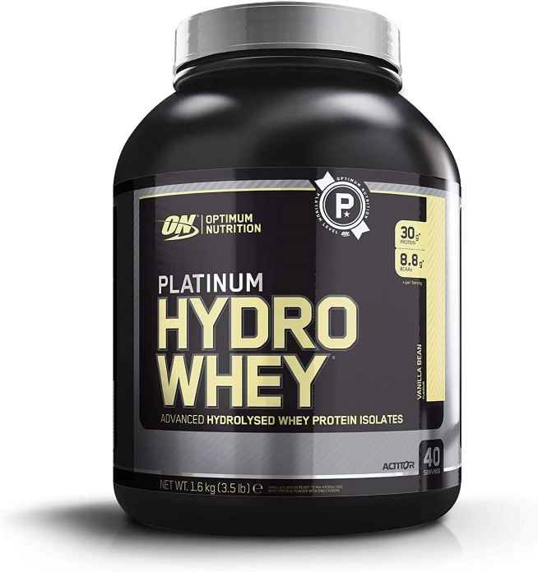
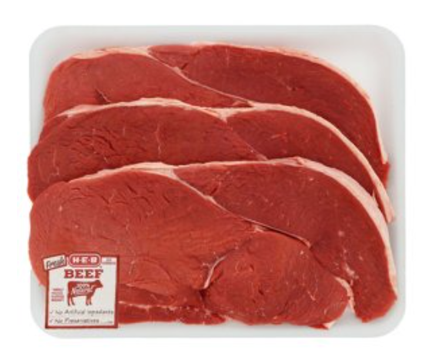
Counter-point #4:
Can be Cost & Time-Effective
3.5 lbs, $62
$1.55/servings
(30 g Pro; 1 scoop)
3.2 lbs, $16.45
$1.60/servings
(30 g Pro; 5 oz)

Slide 44
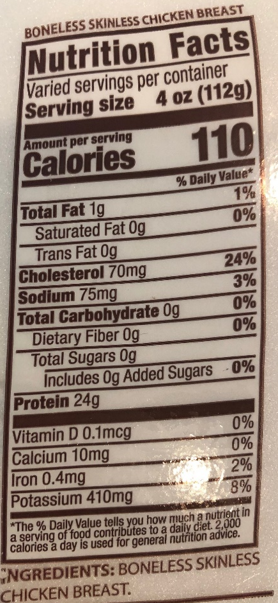
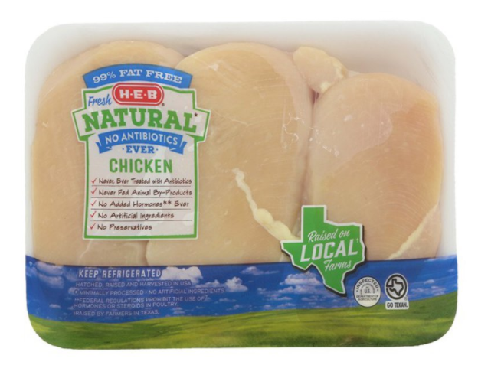
Counter-point #4:
Can be Cost & Time-Effective
3.5 lbs, $62
$1.55/servings
(30 g Pro; 1 scoop)
1.14 lbs, $5.69
$1.55/servings
(30 g Pro; 5 oz)

Slide 45
Questions?

Slide 46
Install Poll
Taking everything into consideration, which side do you now support?
Supplements are an easy and effective way to meet all requirements.
Supplements can be helpful in certain situations, but not for daily use.
Supplements are never needed; all nutrients can be obtained from food.
Not sure

Slide 47
Wrap-up
Position Summary (for this Debate): Due Tues, 4/27
Quiz #5: Due Sunday 4/18
Popular Diet Project, Part I Infographic: Due: 4/22
Upload under the Assignment
Upload to “Popular Diet Project” Student Infographics Discussion Board
See previous announcement re: Extra Credit Chapters
Next Tues: Pre-recording (Chapter 17) – Life Cycle Nutrition
Next Thurs: Live Lecture (Chapters 15-16) – Life Cycle Nutrition
Instapoll results…

